Slide 1
The Day care model
Team 3: Hui Huang, Jun Xiang, Hao Wu

Slide 2



MVC Pattern
CONTROLLER
1
User action
Update
2
4
Update
Notify
3
VIEW
MODEL
Notes:
We designed the day care model based on Model View Controller framework.
The Model View Controller (MVC) design pattern specifies that an application consist of a data model, presentation information, and control information.

Slide 3
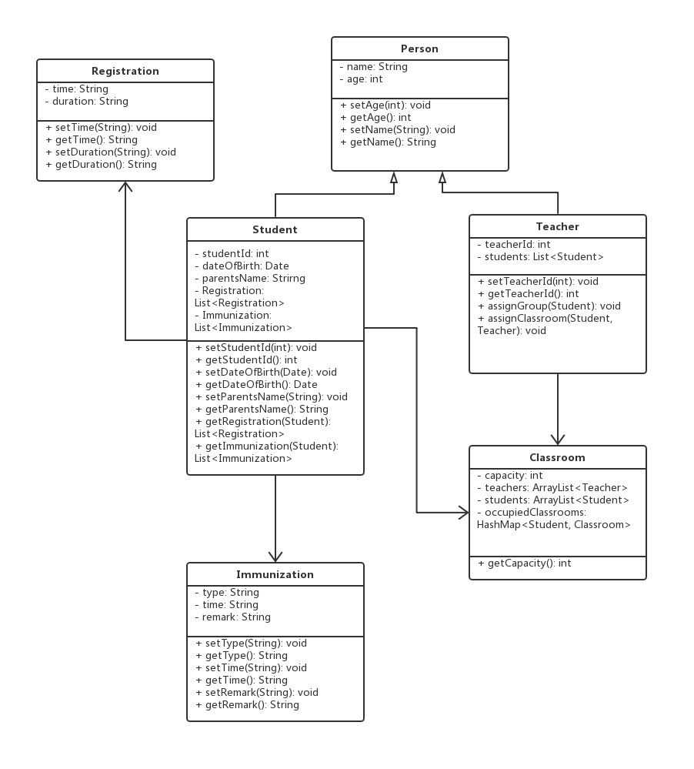
MODEL
Notes:
We will start with the model.
The model we designed consists of Person class, Student class, Teacher Class, Classroom class, and the Immunization and Registration class used to record specific information.
介绍每个类的属性和方法。以及他们之间的关系
So that is an introduction to our model part.
Here now is Jun to talk about the view and controller part of the day care model.
Jun

Slide 4
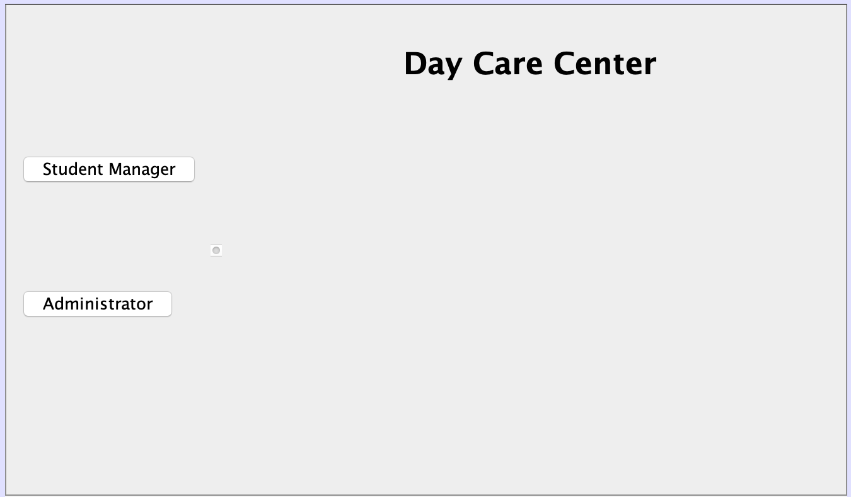
VIEW
Initial Interface
Notes:
Ok now, Let’s me introduce the specific work of the day care model we designed from the Graphical User Interface.
This is the initial window when you run the project.
In order to satisfy the requirements of this assignment, We designed two user roles: Student Manager, and Administrator.
I will introduce all the operations a student manager can do. And then my partner Harold will present the other functions from the administrator’s point of view.
When we click the student manager button.【切换到下一张ppt】

Slide 5
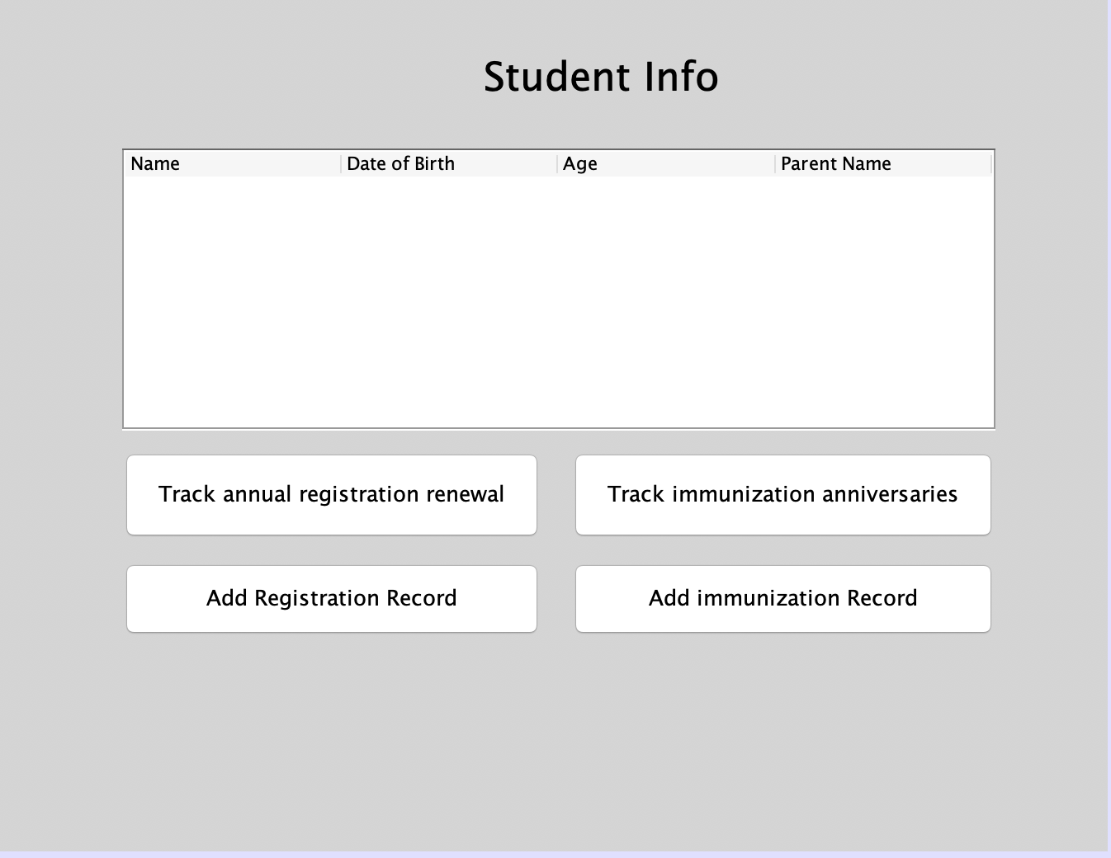
VIEW
Student Manager
Notes:
The right panel will switch to this interface.
We can see a table of student information that csv file imported. Students’ Name, their date of birth, and age, parent name
And then, we look at the bottom part of the interface, there are four buttons: ADD TRACK ADD TRACK
Each button is like a controller of MVC design pattern. User can click the button, send user action to the controller, and in the end, view the results model updated at the next interface.
First we can add a registration record.【切换到下一张ppt】

Slide 6
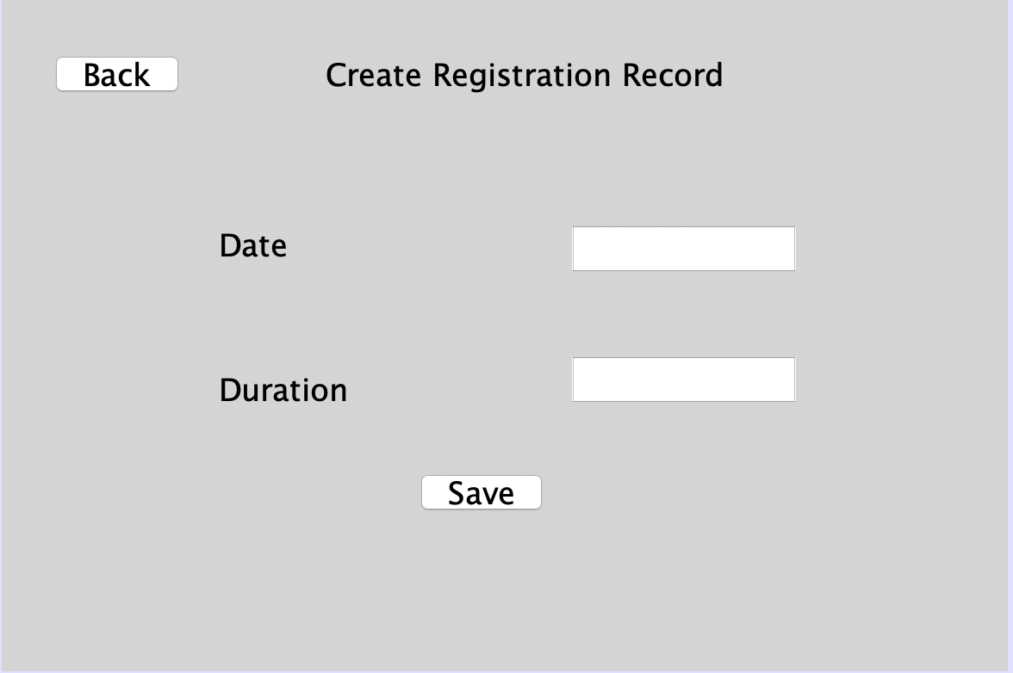
VIEW
Add Registration Record
Notes:
Input the date of registration, and duration of caring children, like one month, or two month at the textfied
And click save button, the data will be stored. Then, we can click back button, to return previous interface,.

Slide 7
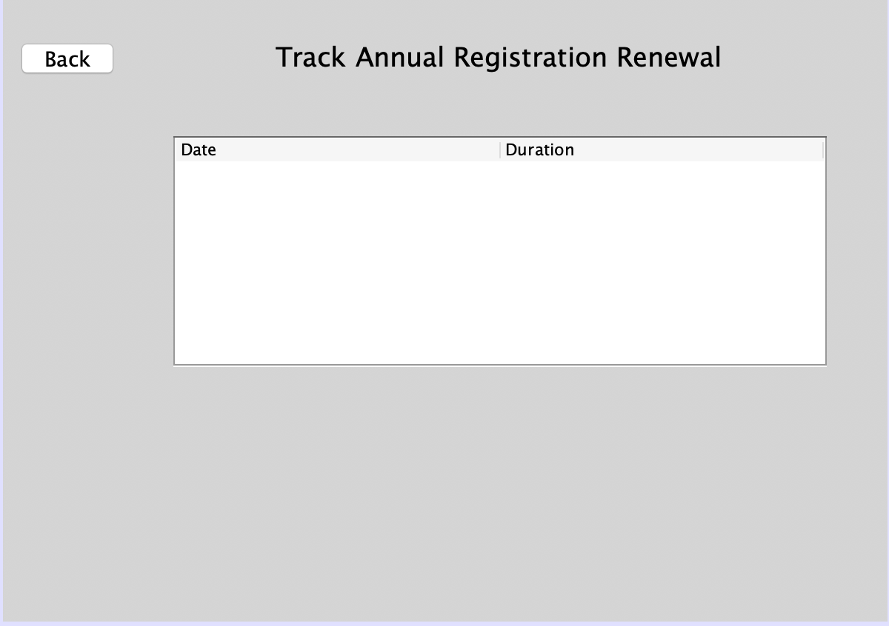
VIEW
Track annual registration renewal
Notes:
click track button to check the data which would show in the table.

Slide 8
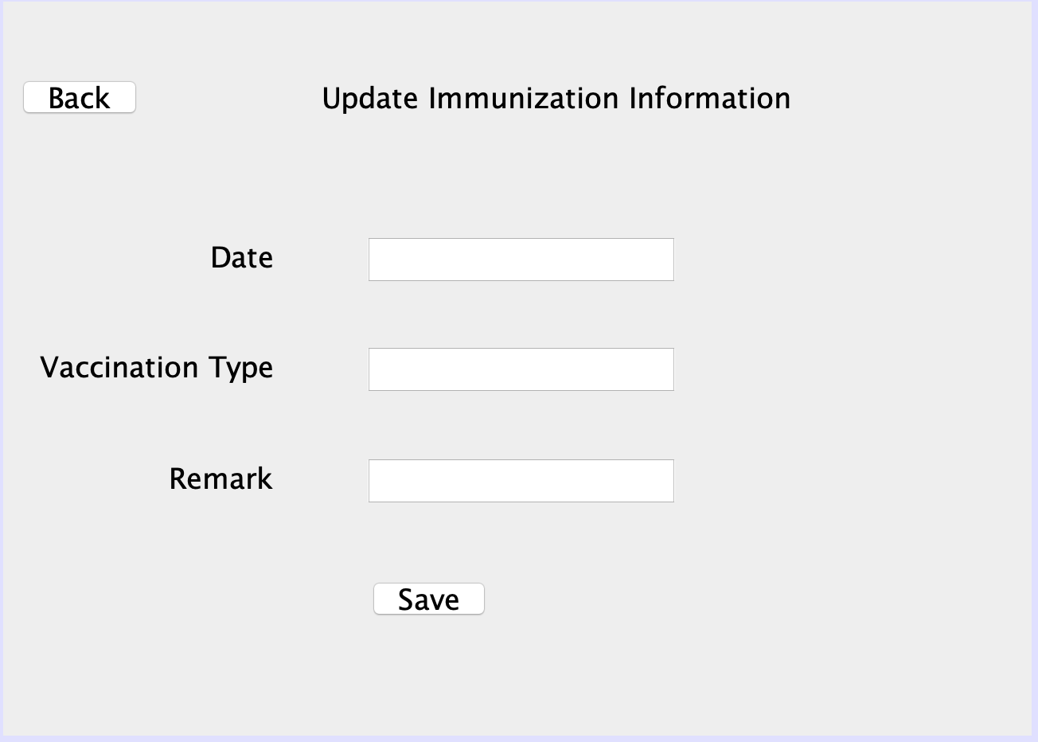
VIEW
Add immunization Record
Notes:
In a similar way, we can input the immunization information through clicking the add immunization record button and the save data.

Slide 9
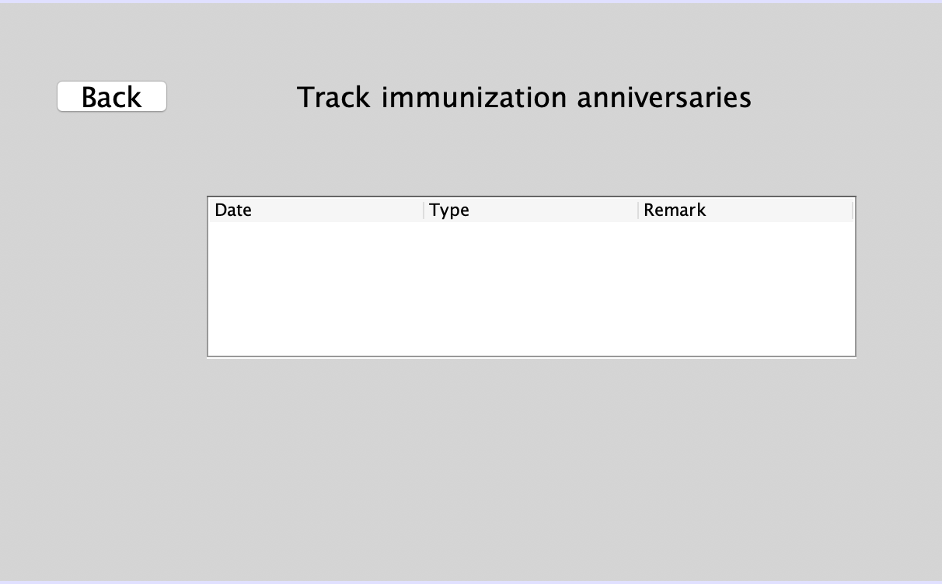
VIEW
Track immunization anniversaries
Notes:
And then to track these records.
So that is an introduction to the specific operations a student manager can do.
Here now is Harold to talk about other operations the administrator can do.
Harold

Slide 10
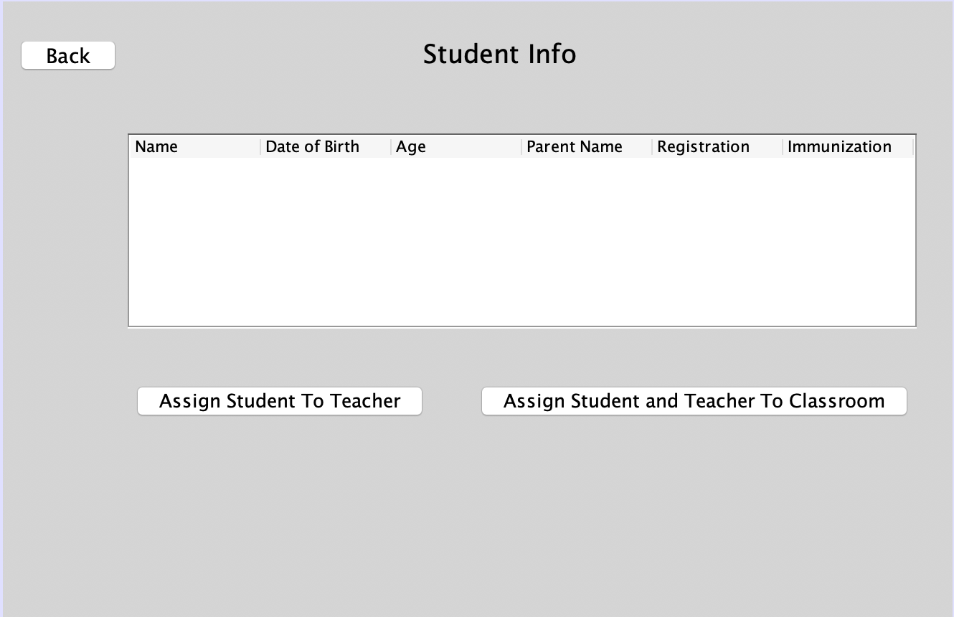
VIEW
Administrator
Notes:
Now let’s show you the manipulations the administrator do.
When you click “administrator” button, the right panel switch to this interface.
All the information of children will be showed in the table, their names, date of birth, age, and registration records, immunization records.
The administrator can do two operations, “Assign student to teacher” “assign student and teacher to classroom”

Slide 11
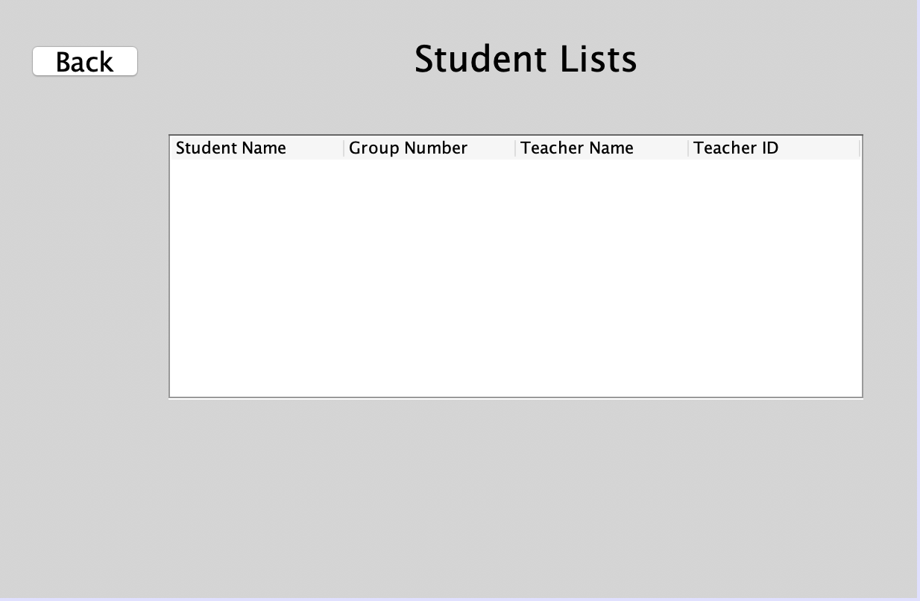
VIEW
Assign students to Teachers
Notes:
First, assign students to teachers according to the state regulation rules.

Slide 12
State Regulation Rules
Age (months) | Group Size | Ratio | Max Groups/Room
6-12 | 4 | 4:1 | 3
13-24 | 5 | 5:1 | 3
25-35 | 6 | 6:1 | 3
36-47 | 8 | 8:1 | 3
48-59 | 12 | 12:1 | 2
60 on up | 15 | 15:1 | 2
Notes:
For instance, For kids age from 6 to 12 months, a group consists of four kids, and assign a teacher to each group.
And other kids will also be assigned to different teachers in the same way.
Traverse the students list, put the kids age from 6 to 12 months in to a new list, form a group,

Slide 13
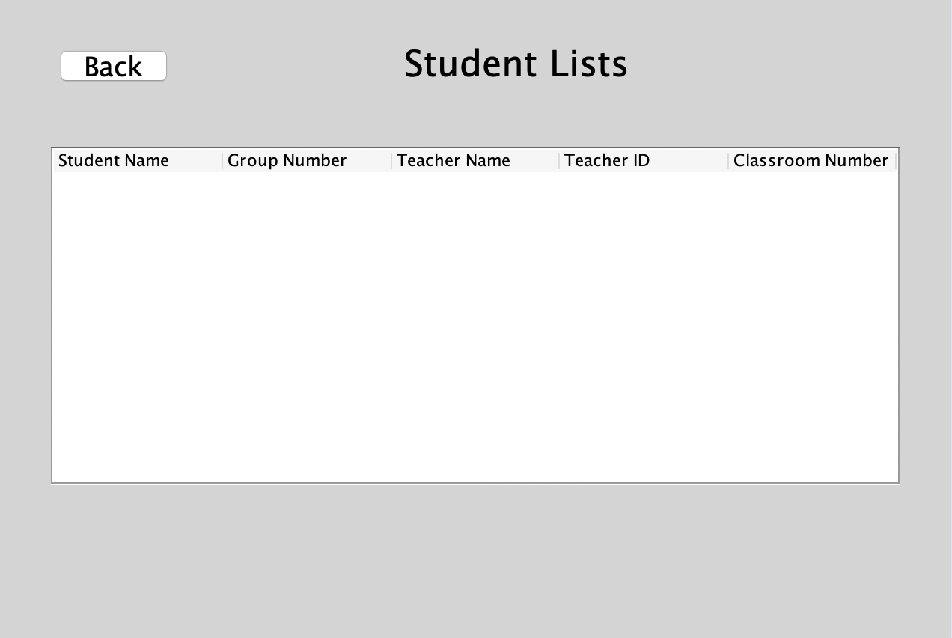
VIEW
Assign students and Teachers to classrooms
Notes:
The second function is to assign students and Teachers to classrooms according to the state regulation rules.
Take the same example, for kids age from 6 to 12 months, a classroom can contain three groups.

